Slide 1

Efficacy and unintended consequences of hard-stop alerts in electronic health record systems: a systematic review
Journal of the American Medical Informatics Association, 2018, Vol. 0, No. 0

Slide 2
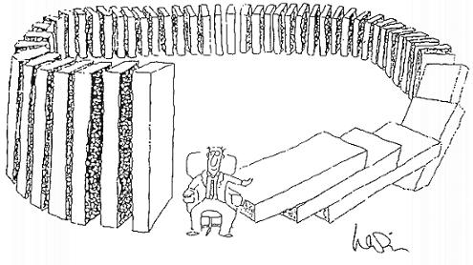
Overview
Study Background
Methods
Data
Evaluation
Implications

Slide 3

Evaluation
PICO
Population/Problem/Patient
Intervention
Comparison
Outcome
Time
Meta-analysis
Selection
Quality
Bias
Selection
Publication
Small-study effect
Data analysis heterogeneity

Slide 4
Study Background
Clinical decision support (CDS) hard-stop alert are increasingly common but can be problematic

Slide 5
Types of CDS
Alerts and reminders
Clinical guidelines
Order sets
Patient data reports, dashboards
Documentation templates
Diagnostic support
Reference information
HIMSS

Slide 6
Why CDS alerts?
Medication errors occur in 4-6% of ALL medication orders
25-30% of all ADE were preventable
CDS may improve ADE by 80-85%
20% of alert dismissals inappropriate
49 additional minutes processing alerts
50-95% of all alerts are over-ridden
Clinicians can get up to 56 alerts per day
McCoy 2014

Slide 7
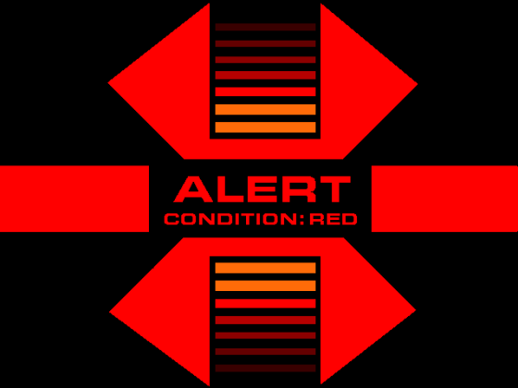
CDS Alert Types
Passive –
directs the user toward the most appropriate practices unobtrusively
conditional order sets
limited selections (ie: drop-down lists, check boxes)
Active
Noninterruptive
new patient information is posted to work queue/lists or forms
resolution at a time convenient to the clinician
Lab values, allergy information
Interruptive – require direct user interaction
Soft Stop – user is able to override the action
Hard Stop – user is not able to override the action (although may still accomplish task with third party)
ASHP Section of Pharmacy Informatics and Technology Section Advisory Group on Clinical Information Systems, 2015

Slide 8
Unintended Consequences
elimination or shifting of human roles (check reduction)
difficulty in keeping content current
inappropriate content (errors)
rigidity of the system
potential for errors
Over-reliance on technology
Workflow and communication changes that adversely effect care
New errors
Workarounds
Delays in patient care
Alert fatigue
(AMIA 2007 Symposium, Ash, 2007)
(AHRQ Publication No. 11-0105-EF, 2011)

Slide 9
QUESTION: Clinical decision support (CDS) hard-stop alert are increasingly common but can be problematic
To what extent are hard-stop alerts effective in improving patient health and healthcare delivery outcomes?
What are the adverse events and unintended consequences of hard-stop alerts?
How do hard-stop alerts compare to soft-stop alerts?

Slide 10
Background
Increase in CPOE and EHRs
23.9% to 86.9 in last 10 years
Alerts triggered by 6-8% of all physician orders
90-95% of all alerts are over-ridden

Slide 11
Methods
Systemic Review of Biomedical Literature
Pulled “hard stop” literature
Disagreement in definition of “hard stop”
16 with similar enough terms
3 defined as “soft stops”
2 not clearly defined enough
MeSH: MEDLINE, Cochrane, Web of Science, Engineering Village
Gray Literature: National Institute of Care Excellence (NICE), EMIS, Vision, System One

Slide 12
Study Selection
826 Initial Studies
3 independent reviewers
Reviewed abstracts and titles
114 met initial review
2 independent reviewers
full text article reviews
32 studies met all criteria
Screening process using by Covidence systematic review software

Slide 13

Data analysis
Experimental and observational studies
Quantitative measures of the impact of hard-stop alerts
Qualitative analysis of the experience of hard-stop alerts
Eliminated studies with cofounders
Multiple interventions
Not directly evaluated
Authors were contacted for unclear studies

Slide 14


Study Types
3 Randomized Control
3 Retrospective Cohort
18 Pre-post Studies
5 time study series
6 Prior to 2010
12 Since 2015

Slide 15
Care Areas
14 Inpatient care
4 Emergency medicine
5 Primary Care
3 Anesthesia
2 Pediatrics
Rest diverse clinics

Slide 16
Medical Conditions
Venous Thromboembolism
Drug-drug interactions
Drug-allergy
Reducing low-yield imaging
Pulmonary CT angiography for Pulmonary Embolism

Slide 17
Study Quality
0 Excellent Studies
8 Good Quality
17 Fair Quality
7 Poor Quality

Slide 18
TYPES OF HARD STOPS
Interruptive
Dialog box
Message requiring interaction
Unable to proceed without resolving
Most common = order placement
Inline
Within the current workflow
Only required documentation is required
Most commonly to complete documentation
Must abandon task

Slide 19
Outcomes
Health Outcomes
11 of 15 showed improvement
Decrease DVT, improved CTA testing results, reduced repeat drug interaction, radiographic detection of fracture with Ottawa ankle rules
Utilization and Cost Savings
8 of 10 improved as intended
MRI reduction in LBP, transfusion reduction, duplicate labs, stool cultures with hospitalizations
Documentation completion
24 of 26 improvement in process measures
Pain diagnosis scoring, chemotherapy documentation

Slide 20
Adverse Events and Unintended Consequences
11 of 32 studies reported
3 stated no issues, but did not evaluate
Only 2 studies specifically tested
4 delays in medication delivery – study stopped
No increase in bleeding from VTE hard-stop
5 studies noted other changes
Increase in alerts
Shift in care (specialty increase in MRI compared to PCM)
Glycemic control improvement (not ordering metformin instead of recommending insulin)
Decrease in + stool cultures

Slide 21

Soft vs Hard Stops
3 of 4 showed superiority
1 was non-inferior (restraint orders)
1 of 1 showed significant improvement in cost savings

Slide 22
User Experience (10 studies)
4 reported broad acceptance
User engagement
Rapid response to feedback
Multiple iterations
3 reported well accepted
Low-frequency of hard-stops
3 reported poor user reception
Users responded by avoiding using the workflow with hard-stops
Suspected false input to satisfy workflow
“inaccurate and contradictory clinical documentation to limit time spent in the tool”

Slide 23
To what extent are hard-stop CDS alerts in EHRs effective in improving patient health and healthcare delivery outcomes?
hard-stop CDS alerts were associated with the desired improvements in process measures
80% (8 of 10) showed improvement in the desired healthcare delivery outcome such as lab or imaging costs or ordering rate
improvement in patient health outcomes or healthcare delivery outcomes was less common
50% (4 of 8) showed improvement in patient health outcomes such as detection of pulmonary embolisms common
hard-stop alerts appear to be a useful tool in improving healthcare delivery outcomes, but no conclusion can be made about their efficacy in improving patient health outcomes

Slide 24
What are the adverse effects and unintended consequences of hard-stop electronic alerts?
unintended consequences do occur in association with hard stops
positive or negative
minor or profound
limited number of studies that systematically evaluated this area

Slide 25
How do hard-stop alerts compare to soft-stop alerts in efficacy and unintended consequences?
hardstop alerts appear to be superior to soft-stop alerts in achieving the desired process outcomes
No other conclusions from patient health, healthcare delivery outcomes, and unintended consequences

Slide 26
Implications for practice
Should be harder to override alerts for critical issues
A lack of user testing and iterative design is more likely to lead to unintended consequences
Positive outcomes
integrating important clinical decision-making aids(recent relevant lab results)
specific score or risk calculators
triggering the alert at a natural and relevant place in the workflow
providing the possibility for a third-party override, such as telephone discussion with a pharmacist or radiologist

Slide 27
Research Implications
clearly defined: patient health outcomes, healthcare delivery outcomes, adverse events, and user experience
include sufficient technical details to allow for replication elsewhere (esp screenshots)
RTCs over Pre/Post would be preferred
Followed over longer period of time

Slide 28
Limitations
lack of sufficient high-quality studies
No heterogeneity in the design and setting of the alerts
strength of the conclusions and generalizability
existence of significant publication bias, alerts with positive results are likely to be published

Slide 29

Review
Selection
Quality
Bias
Selection
Publication
Small-study effect
Data analysis heterogeneity

Slide 30

Moving Forward
Did this add to our understanding?
What can we learn from this?
Will this change what we do?

Slide 31

10 Commandments For Effective CDS
Speed is everything
Deliver information when needed
Fit into user’s workflow
Improve usability
Offer alternatives rather than stopping an action
Changing defaults such as dose, route, or frequency can change behavior
Fit guidelines to one page
Request additional info carefully, less asked, better results
Monitor impact – if some reminders never followed, eliminate
Maintain knowledge base – update as needed

Slide 32
5 RIGHTS
the right information
evidence-based guidance
response to clinical need
to the right people
entire care team
including the patient
through the right channels
EHR
mobile device
patient portal
in the right intervention formats
order sets
flow-sheets
Dashboards
patient lists
at the right points in workflow
decision making
action

Slide 33
Improving alerts
Alert evaluation framework
Monitoring and Evaluation Process
Responsiveness
http://www.leapfroggroup.org/survey-materials/get-started

Slide 34
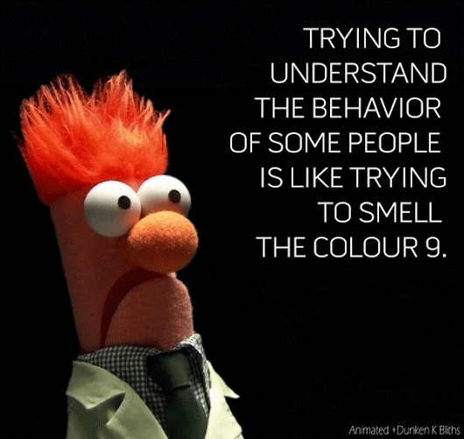
Questions?

